Slide 1
Dental Radiography Systems
Course: BMED434 – Medical Imaging
Awab Abdallah 22700366
Date: 2/6/2025

Slide 2
Introduction
Importance of dental radiography
Types of systems: Intraoral, Extraoral
working principles
device structure
calibration, and safety
Application

Slide 3

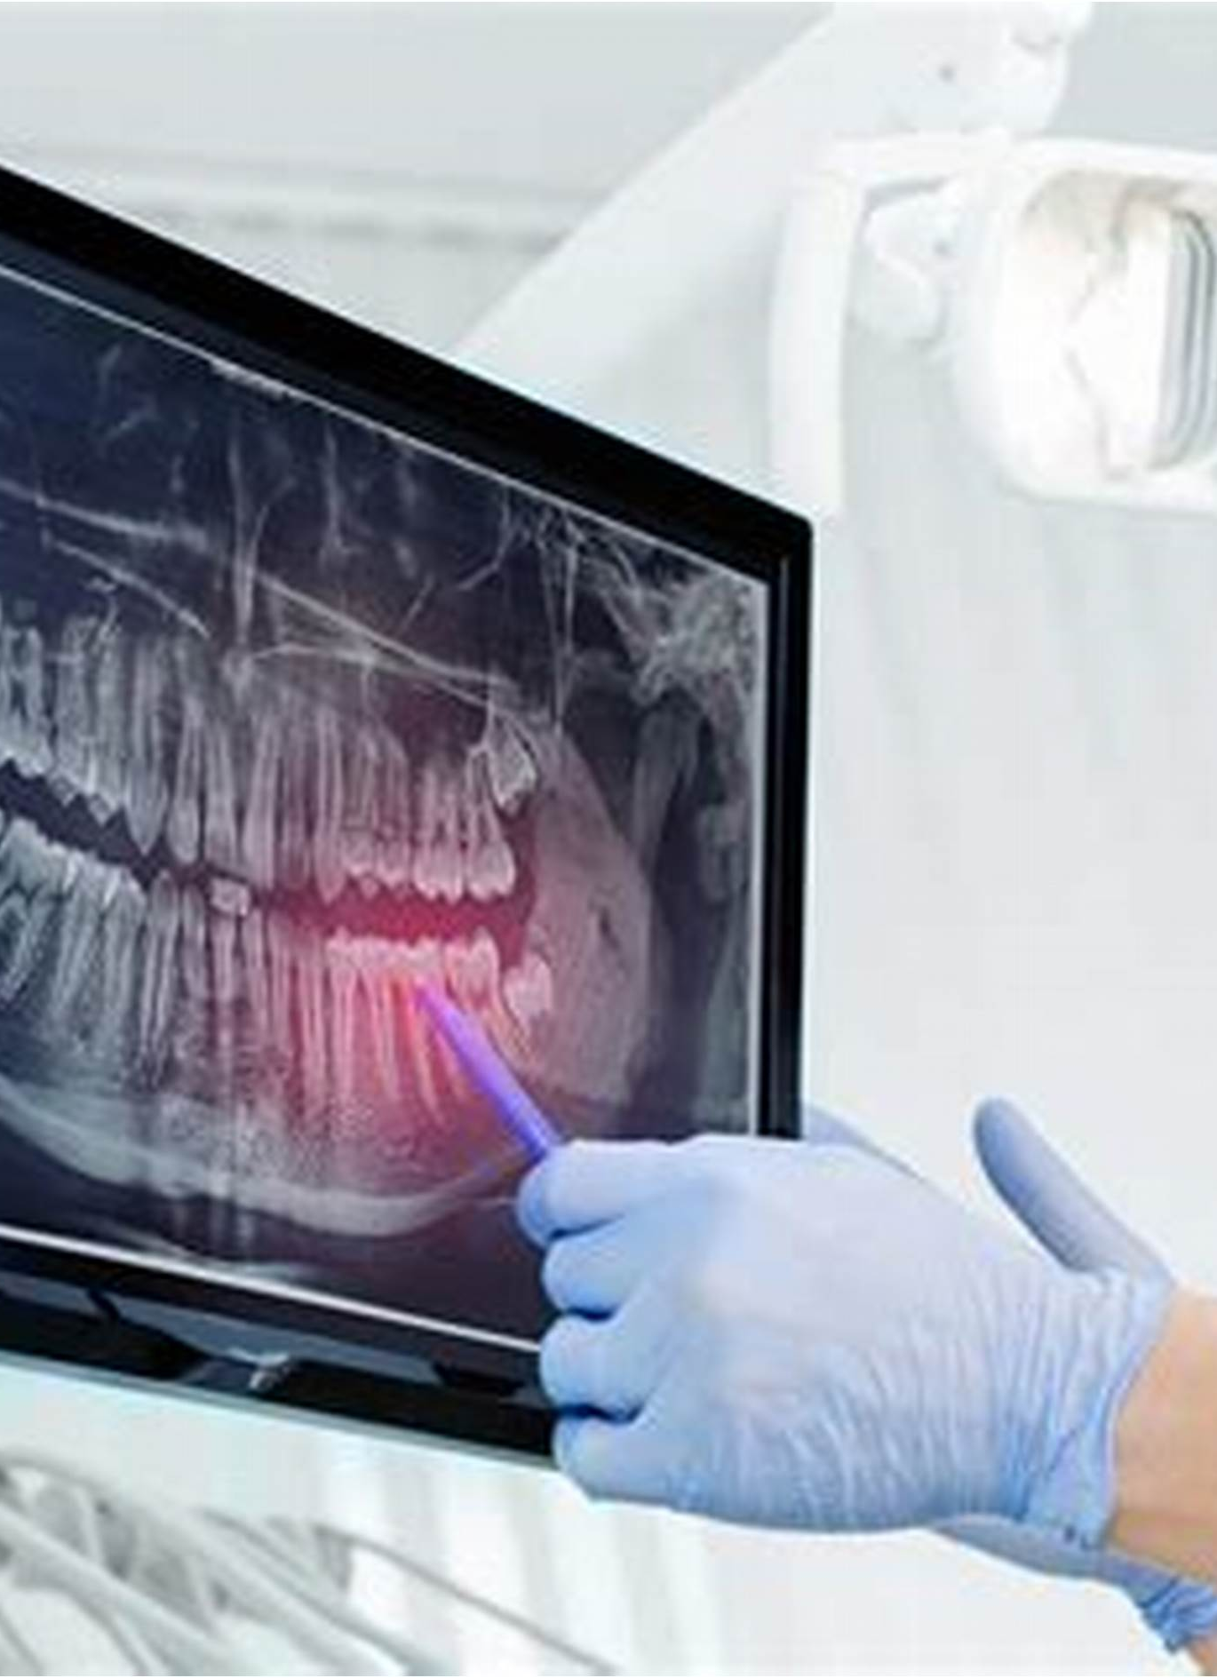
What Is Dental Radiography?
Imaging technique.. teeth, jaw, and oral structures
diagnosis of decay, infection, bone loss, and more

Slide 4
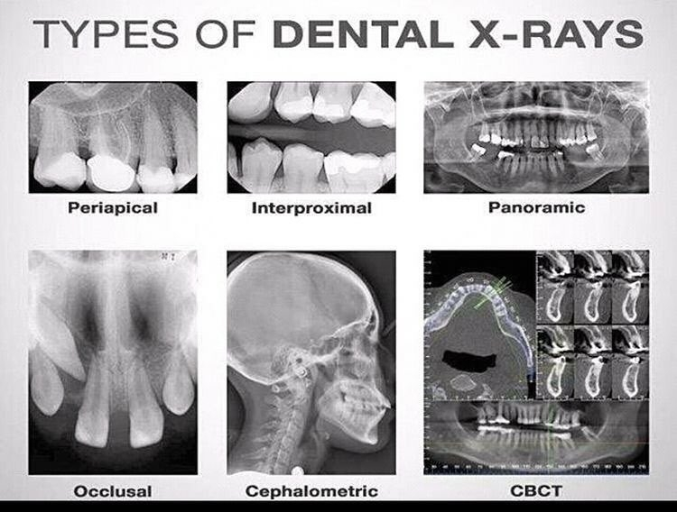

Slide 5
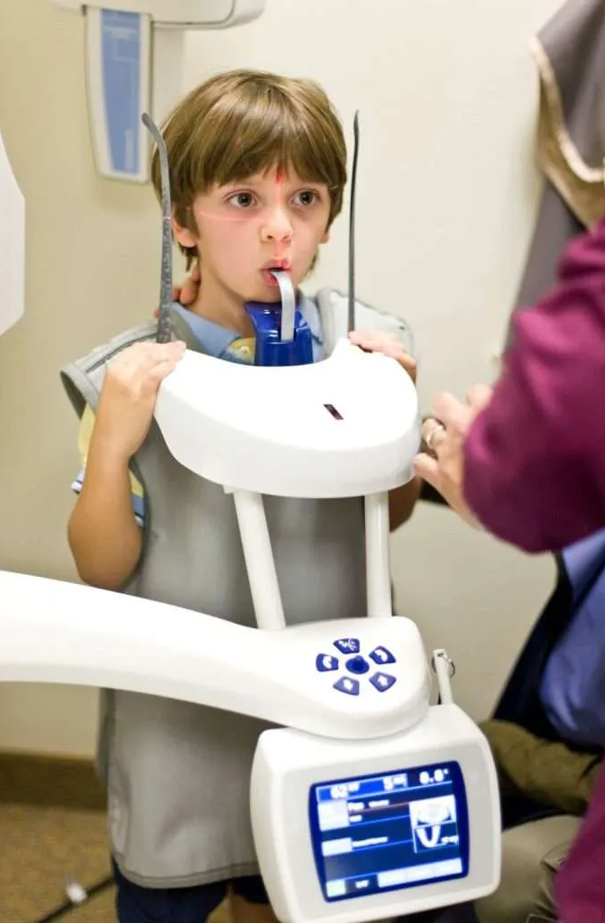




[ X-ray Machine ] ---> [ Mouth ] ---> [ Sensor/Film ] ↓ ↓ ↓ Sends X-rays Teeth & bones absorb Image formed X-rays → lighter → shows teeth, Soft tissue passes bones, cavities X-rays → darker

Slide 6
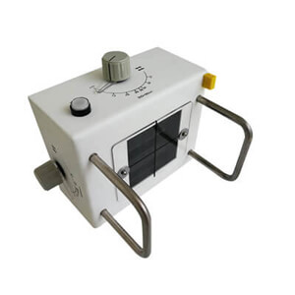
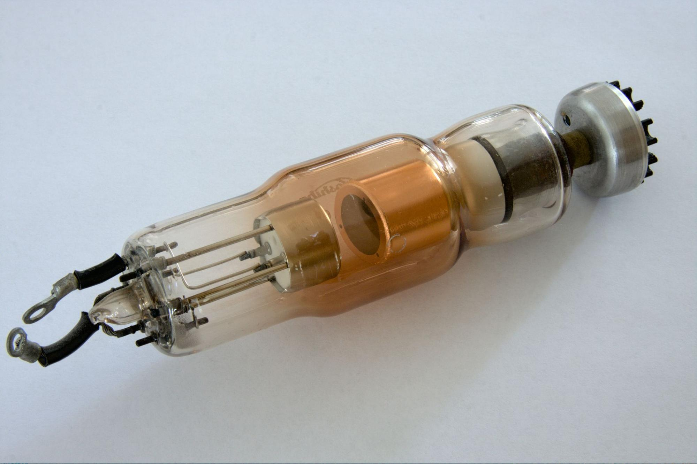
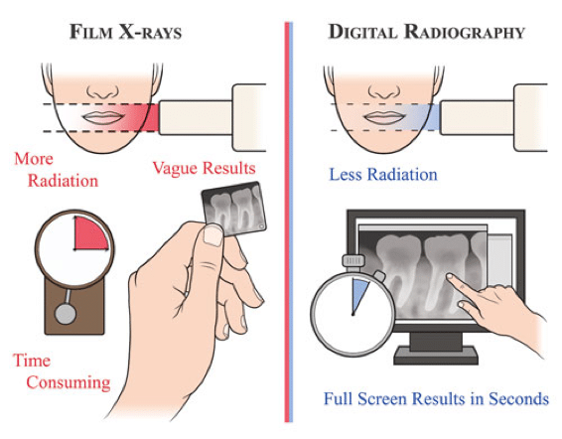
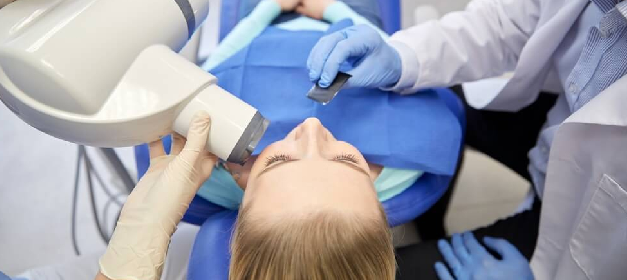
System Components Tube Head Extension Arm Control Panel Image Receptor: Film, digital sensor Embedded Systems

Slide 7
Calibration Methods
Mechanical Calibration: Beam alignment, movement check
Electrical Calibration: kVp, mA, exposure time, dose

Slide 8
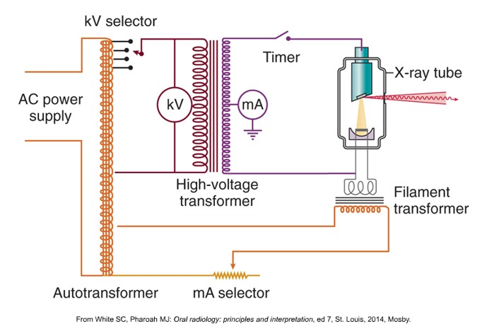
high-voltage circuit low-voltage circuit control circuits

Slide 9
Standards & Regulations
Dental X-ray systems must follow
IEC 60601 ensures the equipment is safe.
IAEA and WHO give guidelines for radiation protection.
Each country , handles licensing and inspections.

Slide 10
Applications
Routine dental exams
Orthodontic planning
surgical guidance
Endodontic (root canal) evaluation

Slide 11
Conclusion
Understanding system components and regulations ensures optimal performance , Continuous training and calibration are essential

